Slide 1
Boyle’s Law

Slide 2
What is Boyle’s Law?
Boyle’s Law is one of the laws in physics that concern the behaviour of gases
When a gas is under pressure it takes up less space:
The higher the pressure, the smaller the volume
Boyles Law tells us about the relationship between the volume of a gas and its pressure at a constant temperature
The law states that pressure is inversely proportional to the volume

Slide 3
How can we write Boyle’s Law as a formula?
Pressure is inversely proportional to the volume and can be written as:
Pressure α 1/volume
P=pressure in N/m²
V=volume in dm³ (litres)
k=constant
This is more usually written as:
Pressure = constant
volume
PV=k
P₁V₁=P₂V₂

Slide 4
How can we investigate Boyle’s Law?
When investigating Boyles law a given volume of gas is sucked into a cylinder and the end is sealed
The temperature of the gas is kept constant
Using several equal weights we can apply increasing pressure to the gas
We can calculate the pressure by dividing the force applied by the area of the top of the cylinder
The volume will be shown on the scale on the cylinder

Slide 5
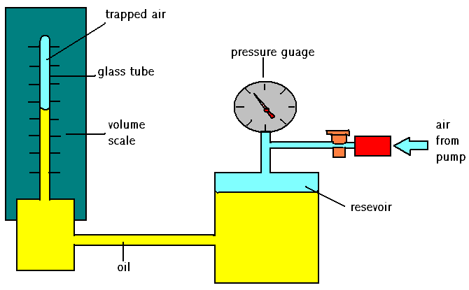
Boyle’s Law apparatus

Slide 6
Below are some results of an experiment
Pressure p
Volume V
P x V
1.1
40
44
1.7
26
2.2
20
2.6
17
Calculate pV (pressure x volume) for each set of results. What do you notice?

Slide 7
What these experimental results show
The pressure x volume for each set of results remains constant
This is called Boyle’s Law
For a fixed mass of gas, at constant temperature, pV = constant or
P₁ x V₁ = P₂ x V₂
Let us look at the results again

Slide 8
Here are the results of the experiment
Pressure p
Volume V
P x V
1.1
40
44
1.7
26
44
2.2
20
44
2.6
17
44
Did you notice that if p is doubled, V is halved?
If p increases to 3 times as much, V decreases to a 1/3rd . This means:
Volume is inversely proportional to pressure, or
V ∝ 1
p

Slide 9
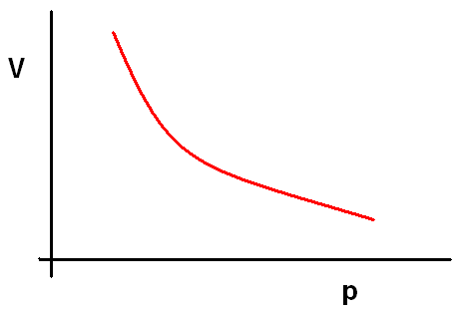
What sort of graphs would this data give?
If we plot volume directly against pressure we would get a downwards curve showing that volume gets smaller as the pressure gets larger, and vice versa.

Slide 10
Another way of plotting the data
Curved lines are hard to recognise, so we plot the volume against the reciprocal of pressure (ie. 1/p)
This time the points lie close to a straight line through the origin.
This means volume is directly proportional to 1/pressure or
volume is inversely proportional to pressure

Slide 11
This leads us back to Boyle’s Law
Boyle’s Law: for a fixed mass of gas kept at constant temperature the volume of the gas is inversely proportional to its pressure.

Slide 12
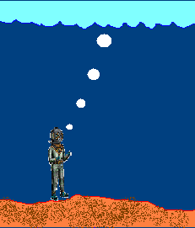
Problem:
A deep sea diver is working at a depth where the pressure is 3.0 atmospheres. He is breathing out air bubbles. The volume of each air bubble is 2 cm². At the surface the pressure is 1 atmosphere. What is the volume of each bubble when it reaches the surface?

Slide 13
How we work this out:
We assume that the temperature is constant, so Boyle’s Law applies:
Formula first: P₁ x V₁ = P₂ x V₂
Then numbers:= 1.0 x 2 = 3.0 x V₂
Now rearrange the numbers so that you have V2 on one side, and the rest of the numbers on the other side of the ‘equals’ symbol.

Slide 14
Here’s what you should have calculated
V2 = 3.0 x 2
1.0
therefore volume of bubbles = 6 cm³
Note that P₁ and P₂ have the same unit, as will V₁ and V₂

Slide 15
This powerpoint was kindly donated to www.worldofteaching.com
http://www.worldofteaching.com is home to over a thousand powerpoints submitted by teachers. This is a completely free site and requires no registration. Please visit and I hope it will help in your teaching.

